Slide 1
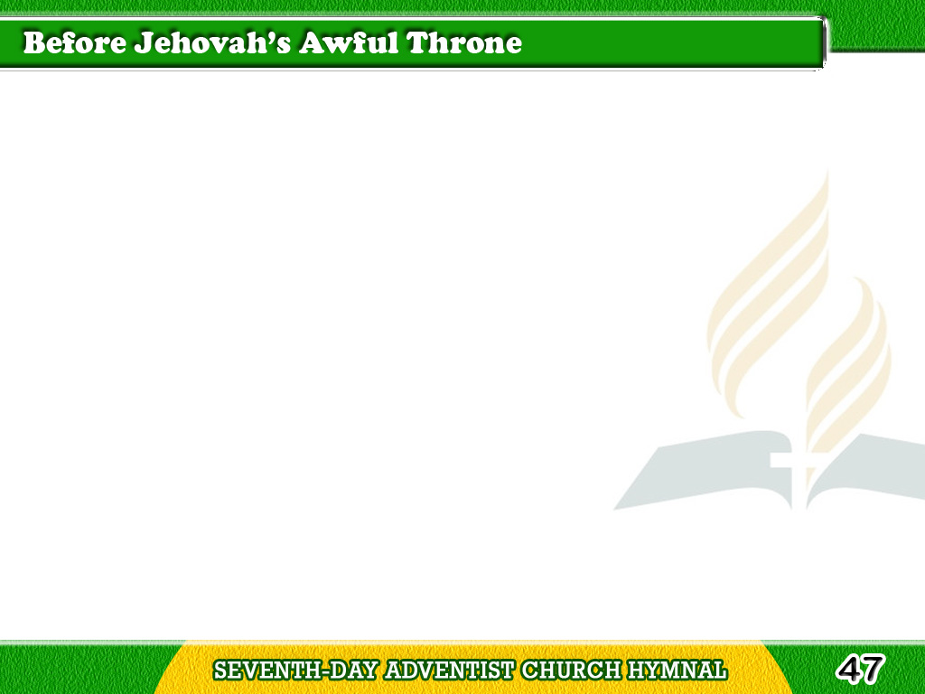
1/4
Before Jehovah’s awful throne,
Ye nations, bow with sacred joy;
Know that the Lord is God alone;
He can create, and He destroy.
Tagalog
Version

Slide 2
2/4
His sovereign, without our aid,
Made us of clay,
and formed us men;
Tagalog
Version

Slide 3
2/4
And when like wandering
sheep we strayed,
He brought us to His fold again.
Tagalog
Version

Slide 4
3/4
We’ll crowd His gates
with thankful songs,
High as the heavens
our voices raise;
Tagalog
Version

Slide 5
3/4
And earth, with her
ten thousand tongues,
Shall fill His courts
with sounding praise.
Tagalog
Version

Slide 6
4/4
Wide as the world
is His command,
Vast as eternity His love;
Tagalog
Version

Slide 7
4/4
Firm as a rock
His truth shall stand,
When rolling years
shall cease to move.
Tagalog
Version

